Slide 1
Card Sort Results
Feb 2024

Slide 2
Overview
Activity to Sort Outcomes from the Fall into Categories
16 people completed it
Participants created a total of 280 categories, with a median of 16 categories each.

Slide 3
Organising Information: Information Architecture
There will be no perfect structure
It is about best match
An grouping based on averages is the worst, we’re trying to understand people's mental model
We have started bottom up, now we iterate from top-down
Tagging will help, but a good default structure will help organise our work
Related: Silver Research Summary
From Bentley Study: Organize the material in the ways that people who use them think about them in the context of the development lifecycle. “Could they be organized in a way that you could determine when to think about them? For example we marked them by role (content, design, developer, tester) so the role who needs to learn it can focus on the guideline but if someone is a content writer they don't need to learn the design and developer guidelines."

Slide 4
Categories
Type of content/interface targeted:
Accessible forms
Audio and visual
Content on hover
Content meaning
Control and focus appearance
Design, layout and Hierarchy
External content
Errors and feedback
Focus states
UI elements
Images
Input types
Interactive elements
Manage distractions
Media accessibility
Motion
Navigation
Cognitive tests
Non-text content
States and updates
Status and purpose info
Images text alternatives
Text presentation
Timing and interruptions
Video
Visual design
Tasks and processes
Timing
UI controls
Use of colour
Video
Visual layout
Wording and terminology
What to provide, or not provide:
Accessible AI
Accommodations
Affordances and consistency
Alternatives
AT Support
Content alternatives
Content structure
Content writing
Understandable content
Design minimums
Enough time
Input support
Keyboard accessibility
Manage distractions
No cognitive tests
No manipulation
Non-visual alternatives
Organisation of content/interface
Prevent distractions
Prevent harm
Privacy
Protect from harm / exploitative behaviours
Provide help
Readability
Safety
Structure & meaning / semantics / organisation
(User) Support
Support input devices
Text alternatives
Text clarity / presentation
Undo
Usability aids
(User) control & freedom
(User) Personalisation
Things user’s can/should be able to do:
Content resize
Task completion
Text manipulation
Type of interaction:
Input
Keyboard /agnostic modality
Layout and approach
Memory
Motor needs
Physical interaction
Perception / visibility
Pointer
Processes & Data entry
Workflow sequence
Discipline:
Interaction design

Slide 5
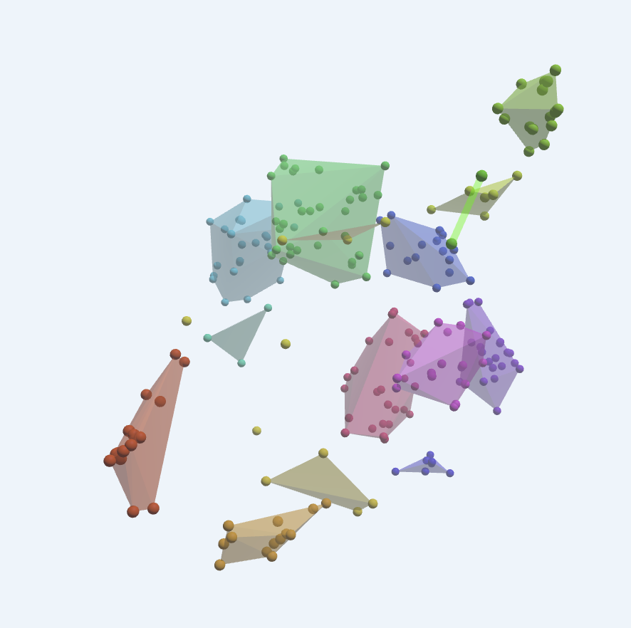
Dendrogram View 1
Clear Language / Wording and Terminology
Ambiguous terminology
Paragraph length
Uncommon words
Verb tense
Non-text content / Media Alternatives
Audio and text descriptions
Captions
Image text alternatives
Decorative / informative equivalent
Structure & Meaning / Organization
Descriptive section headers
Order supports understanding
Related content
Subsections
Design, Layout, & Hierarchy (low score, close to Color/typography/contrast)
Visually distinguished sections
Programmatically distinguished section
Clear relationships
Support Input Devices
Control states
Change focus with pointer input
Gestures and dragging
Keyboard only
Target size
Focus indicator
Color, Typography & Contrast
Adaptable line length
Contrast of visual information
Maximum text contrast
Minimum-sized text
Reflow
Virtual cursor
Adaptability & Customization
Adjust color
Control distractions
Motor fatigue
Notify on change
Text orientation
User settings
Prevent Harm & Deception
3rd party content presentation
Social media algorithms
Feedback
Privacy
Controls
Control Location
Controls distinguishable
Controls vs Non-controls
Indicate interactive
Visually Distinguishable Controls
Consistent Control Design & Interaction / Navigation & Orientation
Behaviour of controls
Clear starting point
Consistent navigation
Control names (accuracy)
Visual indicator for change of context
Processes and data-entry
Adequate time
Contextual help
Input instructions provided
No cognitive tests
Reduced task distractions
Odd ones:
Supplements to aid understanding of numerical concepts
Citation (Visually and programmatically cite the source of the interface and primary content)
Related Information: Information required to understand options is adjacent.

Slide 6
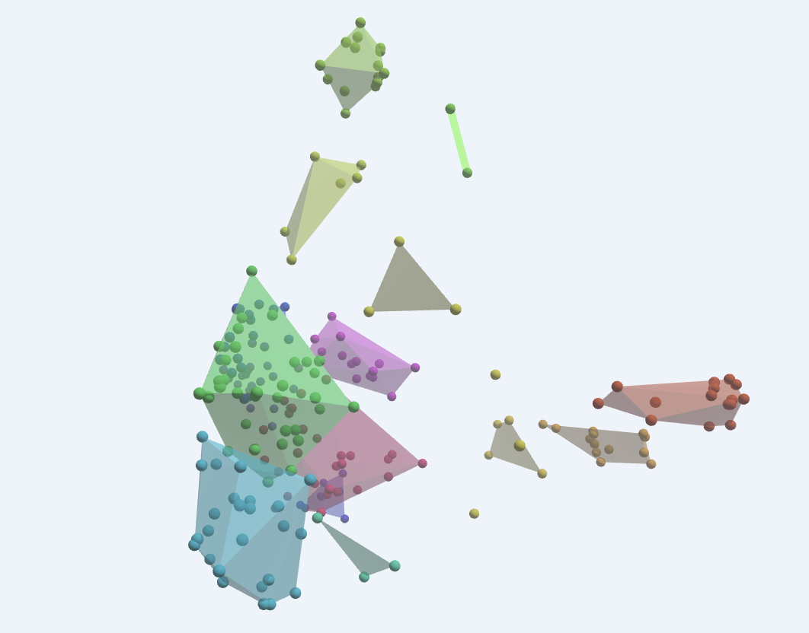
Dendrogram View 2
Prevent Harm & Deception
Algorithm bias
3rd party content
Privacy
Avoid Manipulation
Sourcing
Controls
Consistent control design
UI elements
UI Controls
Orientation
Current location
Focus retention
Consistent Purpose
Relationship of labels & controls
Process and Task Completion
Process & Date Entry
Cognitive Load
Task Completion
Clear Language/Content
Clear Language
Default Content
Wording & Terminology
Alternatives
Non-text content
Alternatives
Media alternatives
Structure & Organization
Structure & Meaning
Structure & Organization
Design, Layout & Hierarchy
Content Organization and Navigation
Input Support
Support Input Devices
Input types
Color, Contrast & Typography
Visual needs
User Control/Adaptability/Customization
Adjust color
AT Control
Customization
Control Distractions
Help & Documentation
Help & Documentation
User Support
Provide Instructions

Slide 7
Comparison
Option 1 | Option 2
Prevent Harm & Deception | Prevent Harm & Deception
Controls | Controls
Consistent Control Design & Interaction / Navigation & Orientation | Orientation
Processes and data-entry | Process and Task Completion
Clear Language / Wording and Terminology | Clear Language/Content
Non-text content / Media Alternatives | Alternatives
Structure & Meaning / Organization | Structure & Organization
Design, Layout, & Hierarchy | [Included in Structure & Organization]
Support Input Devices | Input Support
Color, Typography & Contrast | Color, Contrast & Typography
Adaptability & Customization | User Control/Adaptability/Customization
 | Help & Documentation

Slide 8
Comparison (Adjusted to compare categories)
Option 1 (Type of Content) | Option 2 (What to Provide)
(Prevent Harm & Deception) | Prevent Harm & Deception
Controls | Provide usable controls
Consistent Interaction / Navigation & Orientation | Help user orient
Processes and data-entry | Support Processes and Task Completion
Clear Language / Wording and Terminology | Provide Clear Language/Content
Visual and Auditory Alternatives | Provide alternative formats
Structure & Meaning | Organize and structure content
Design, Layout, & Hierarchy | [Included in Structure & Organization]
Input Agnostic | Support Input
Color, Typography & Contrast | Distinguish content through contrast & clear typography
Adaptability & Customization | Support adaptability & customization
 | Provide help & documentation

Slide 9
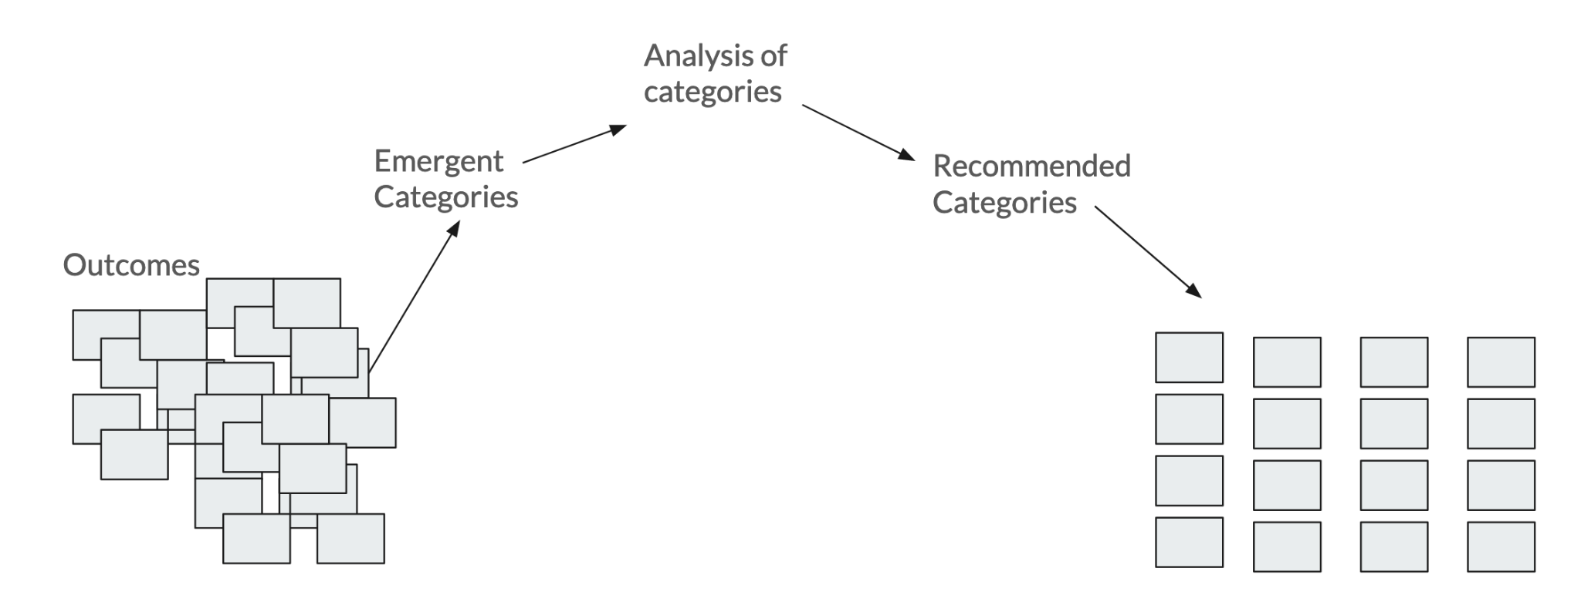
Next steps

Slide 10
Card Sort
Looking at the problem “top down”, how well did the structure work?
Part 2

Slide 11
Refining for a top-down card sort
With categories established, we will setup another card sort, this time a “closed” card sort”.
The list of the outcomes is the same (or a sub-set), but the categories are pre-defined.
When people select from a 1-level menu for each item and are correct 1st time:
Over 75% is excellent
66% is reasonable
Under 50% means you probably want to re-think it.
I thought over 30% of the items had multiple possible locations.

Slide 12
Overlap issues
A few examples of overlap, such as:
Outcome: “Clear control purpose: Provides controls whose purpose is clear”
Design, layout & hierarchy
Controls
Wording and Terminology
Structure and meaning

Slide 13
Overlap issues 2
“Clear input: Makes it clear when user input or action is required (to complete a process)”
“Non-Text Contrast: Visual information required to identify user interface components and states meets the ‘colour contrast threshold’, except for inactive components or where the appearance of the component is determined by the user agent and not modified by the author”
Design, layout & hierarchy
Input agnostic
Processes and data entry
Wording and Terminology
Design, layout & hierarchy
Color, Typography & Contrast

Slide 14
Working up an alternative (1)
Looking at the 60+ cards with obvious overlap:
Where the requirement is to add something (e.g. add help, conversation support) that wasn’t multimedia or preventing harm, there is no obvious category.
“Navigation & Orientation” and “Design, layout & hierarchy” overlap, a lot.
“Controls” and “Input agnostic” have a lot of overlap (e.g. target size)
Error messages could associate with processes or input.
Some harms are during processes
AccName could be in “Controls” or “Structure and Meaning”

Slide 15
Working up an alternative (2)
I tried:
Removing ‘Controls’, ‘Navigation and Orientation’.
Adjusting “Adaptability & Customisation” to “Customisation and Accomodations”
Adjust “Multimedia” to “Multimedia Alternatives”
Adjust “Design, Layout, & Hierarchy” to “Layout & Hierarchy”
Adjust “Adaptability & Customization” to “Adaptation and accommodation”

Slide 16
Alternative
Updated categories:
Prevent Harm & Deception
Processes and data-entry
Wording and Terminology
Multimedia Alternatives
Structure & Metadata
Visual Layout
Input Agnostic
Color, Typography & Contrast
Adaptation and accommodation
However:
“Multiple ways” has no home
“Input and agnostic” still had a lot of overlap.
Structure and metadata still had a lot of overlap (mixing “how” with “what”)
Prevent harm overlaps with some interface areas.

Slide 17
Strict interface-area approach
Taking a purely “what part of the interface does this relate to” approach:
Adaptive features
Animation and movement
Forms, inputs, and errors
Imagery and Graphics
Text and wording
Interactive components
Layout
Media alternatives
Organisation across views
Policy
Careful that none of the categories could be mixed up with roles or activities (e.g. design, code.)
“Organisation across views” for things which don’t happen on one view/page.
“Layout” for what is shown on a view, in relation to other things shown.
“Interactive components” is a big category.

Slide 18
Interaction type approach
Adapting content
Conveying content (to AT)
Discernable content
Input methods
Media alternatives
Preventing harm from content
Understanding
layout
content
input
interactions
processes
Closer to the ‘user-needs’ approach.
Less overlap than the first alternatives, about the same

Slide 19
Comparison
Average
Prevent Harm & Deception
Processes and data-entry
Wording and Terminology
Multimedia Alternatives
Structure & Metadata
Visual Layout
Input Agnostic
Color, Typography & Contrast
Adaptation and accommodation
Interface
Adaptive features
Animation and movement
Forms, inputs, and errors
Imagery and Graphics
Text and wording
Interactive components
Layout
Media alternatives
Organisation across views
Policy
Interaction style / approach
Adapting content
Conveying content (to AT)
Discernable content
Input methods
Media alternatives
Preventing harm from content
Understanding
layout
content
input
interactions
processes

